Slide 1
Model and State Estimation in Hybrid Systems
Maxim Egorov and Andrew Bylard
June 1st, 2016

Slide 2
Outline
Introduction
Hybrid Systems
Interacting Multiple Model Estimator (IMM)
Our Approach: Fast-IMM
Experiments
Conclusion

Slide 3
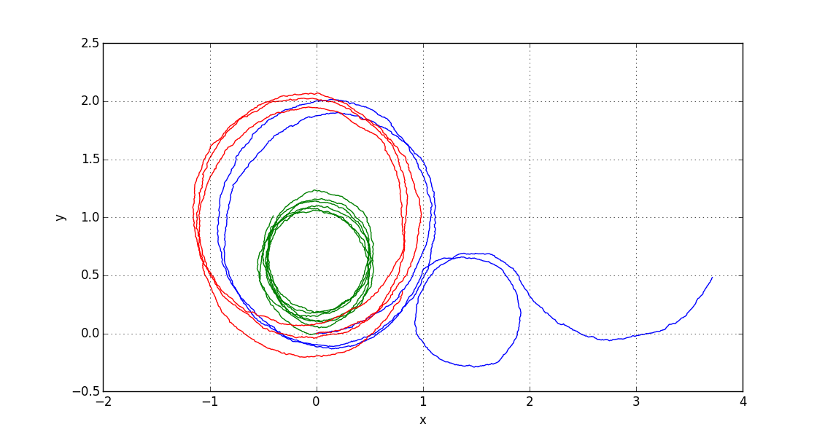
Introduction
How to do state estimation when dynamic model of system varies over time?

Slide 4
Introduction
Two step process:
Estimate continuous state (know how to do this)
Estimate model that drives state dynamics (more complicated)
Applications: target tracking, anomaly detection, behavior prediction

Slide 5


Introduction
Two step process:
Estimate continuous state (know how to do this)
Estimate model that drives state dynamics (more complicated)
Applications: target tracking, anomaly detection, behavior prediction

Slide 6
Hybrid Systems
Formalize: model set, models switch stochastically

Slide 7
Interacting Multiple Model Estimator
Have system with N possible models
M_{t+1} ~ P(M_{t+1}|M_{t})
Closed form solution requires N^{t} filters: Generalized Pseudo-Bayesian Method (GPB)
IMM uses N filters in parallel
3 Steps: interaction, filtering, and combination

Slide 8
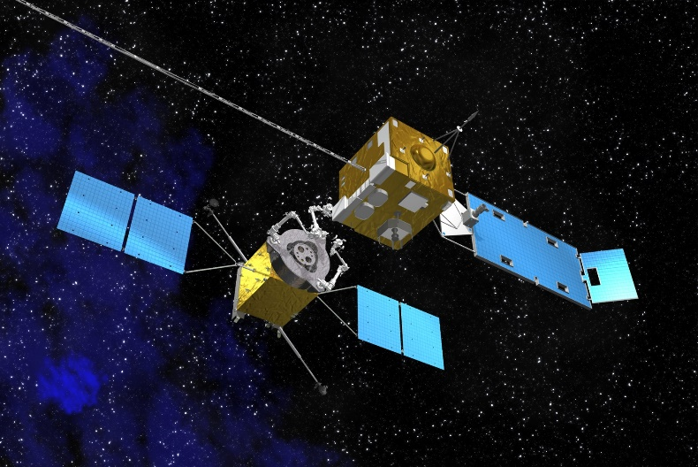
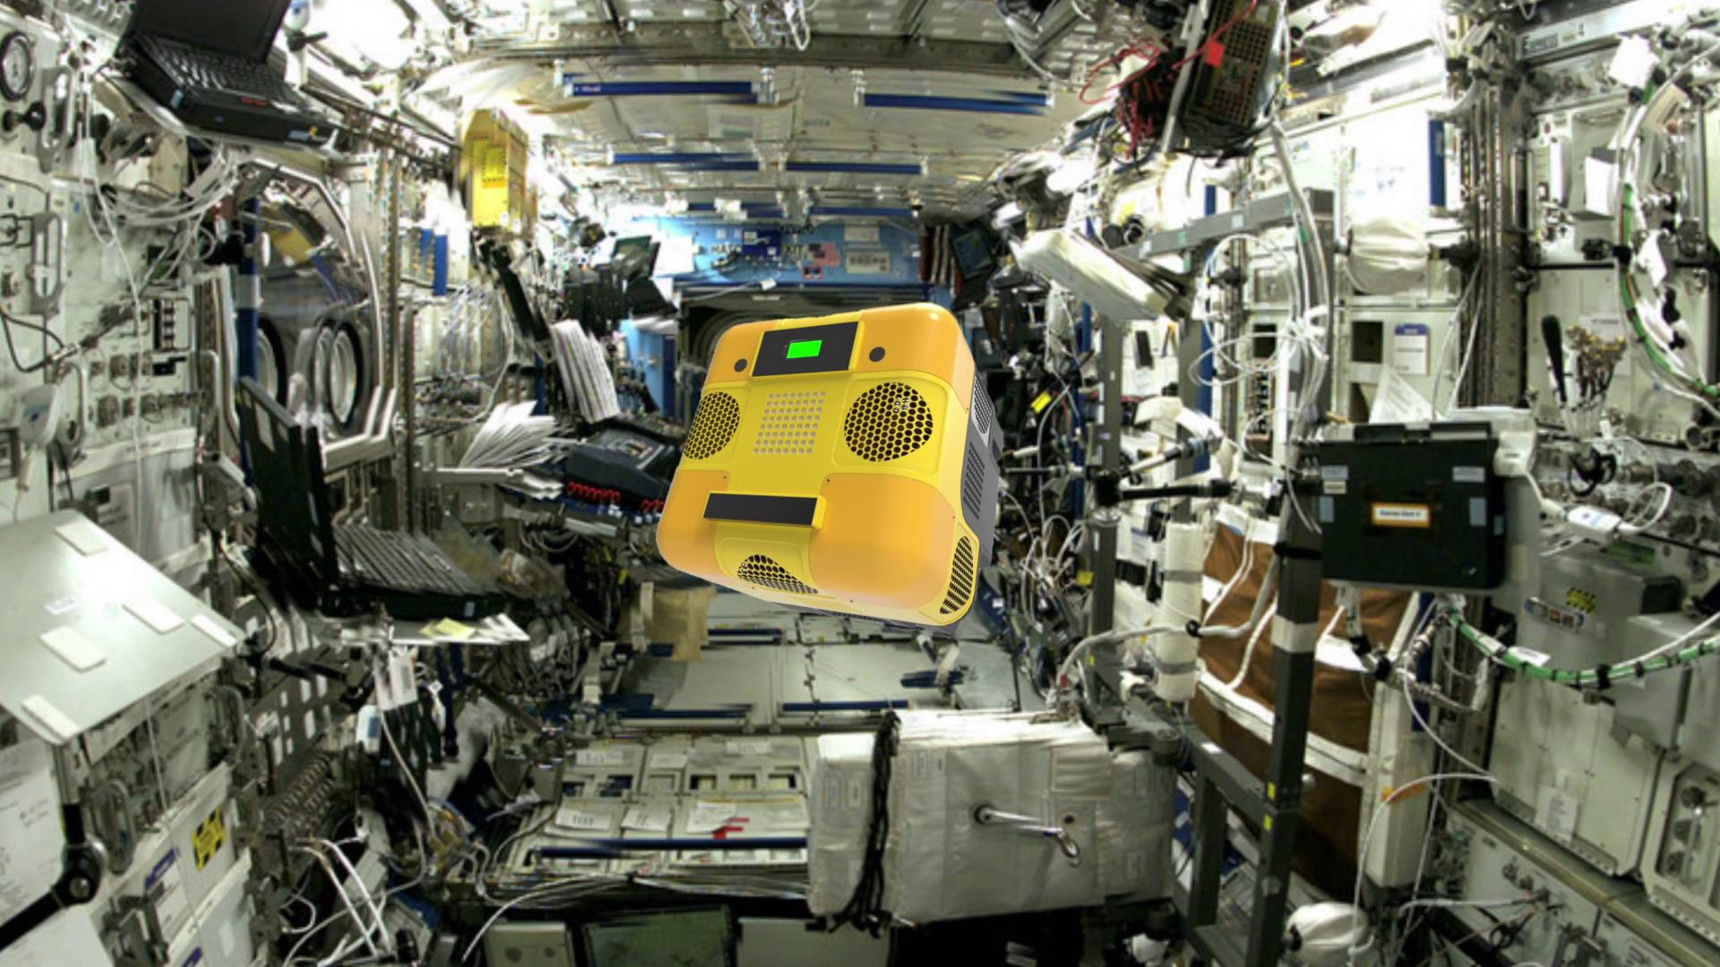
Model Identification + Dual Estimation
Dual estimation problem: Simultaneously estimate states and unknown model parameters
When should parameter estimation be enabled?

Slide 9
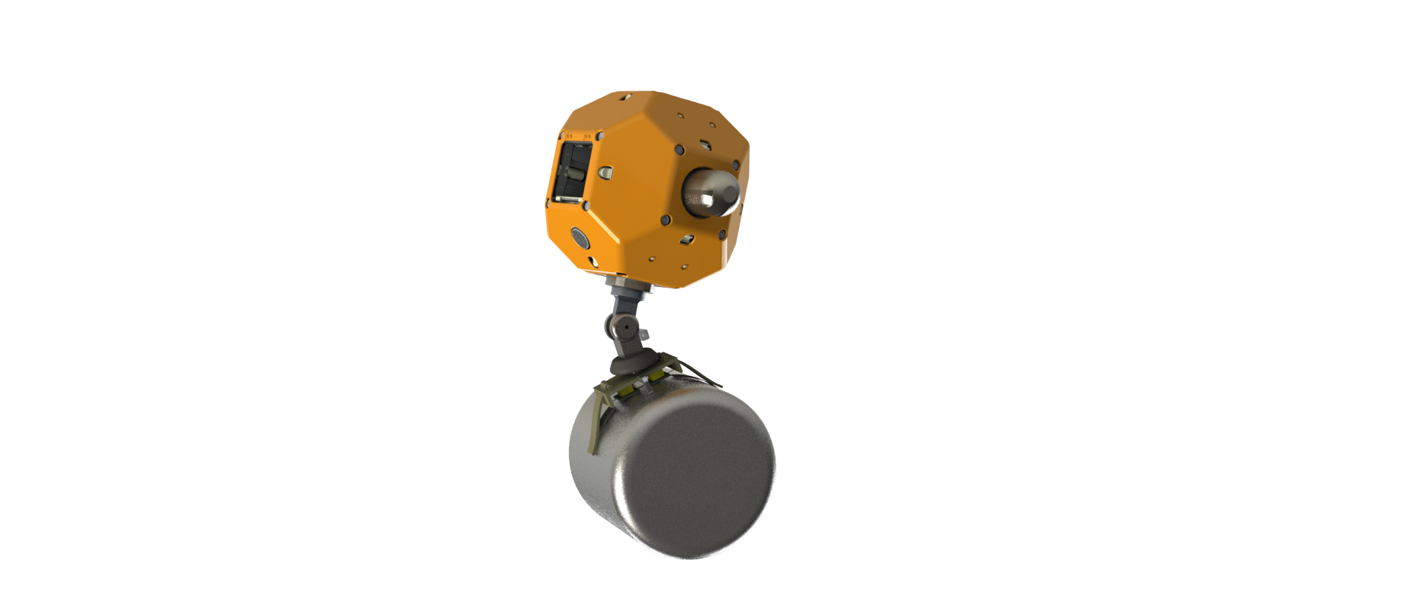
Assistive Spacecraft Experiment
Model Identification
Model 1: No object in grasp
Model 2: Some unknown object in grasp
Parameter Estimation
Properties of grasped object:
Mass
Moment of inertia
Distance to center of mass
Angle to center of mass

Slide 10
Assistive Spacecraft Experiment
Measured with noise:
X, Y Position
Attitude
X, Y Accelerations
Angular Rate
Estimate:
X, Y Velocity
Unknown object parameters

Slide 11
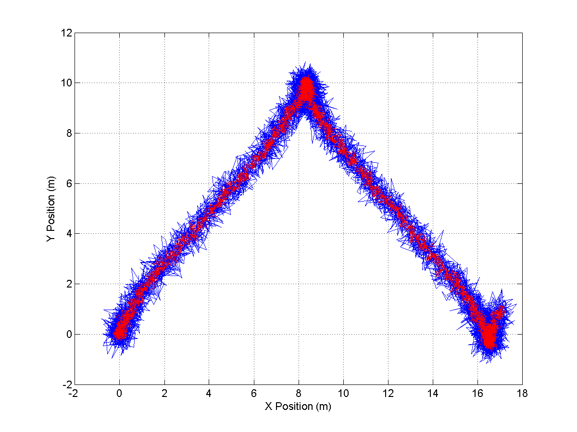
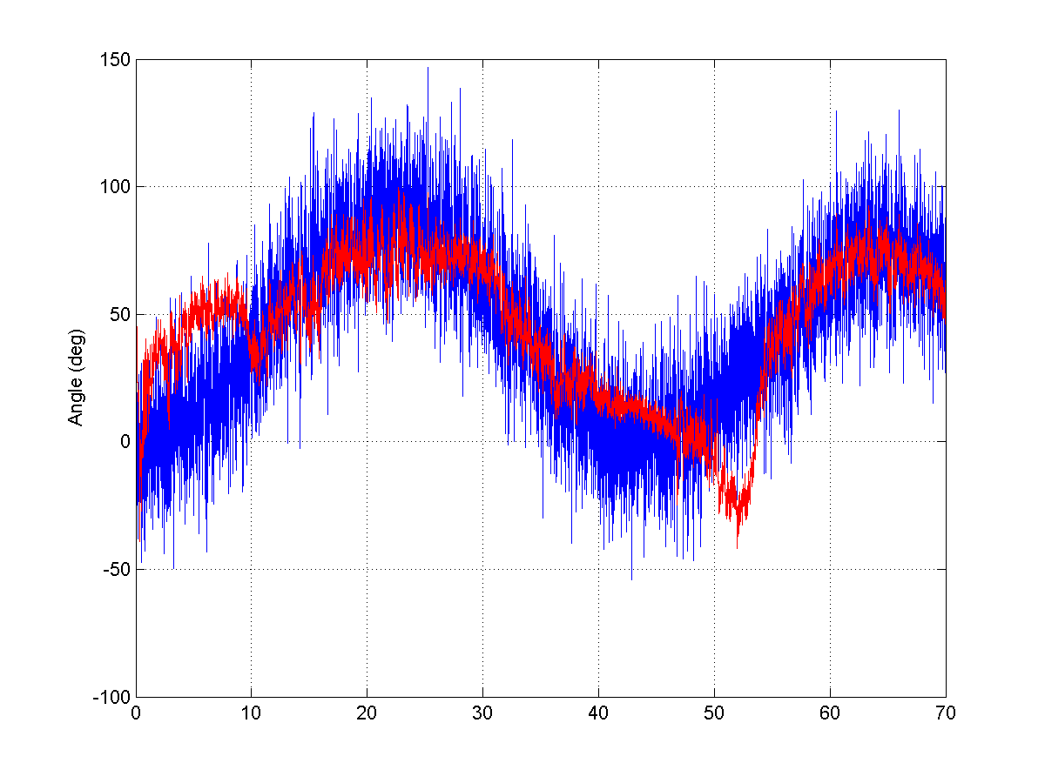

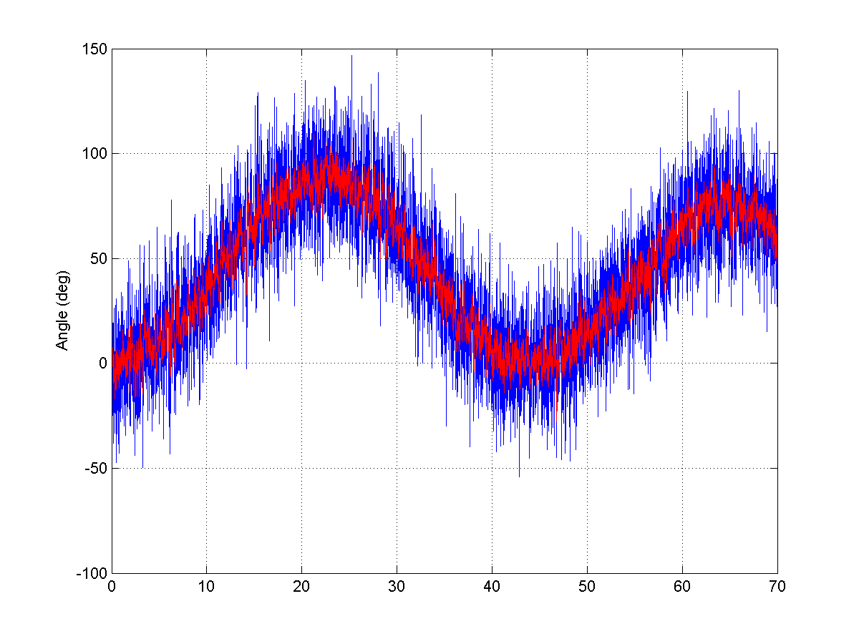
Assistive Spacecraft: No object in grasp
Model 2
Model 1 (true)
Trajectory
Angle

Slide 12
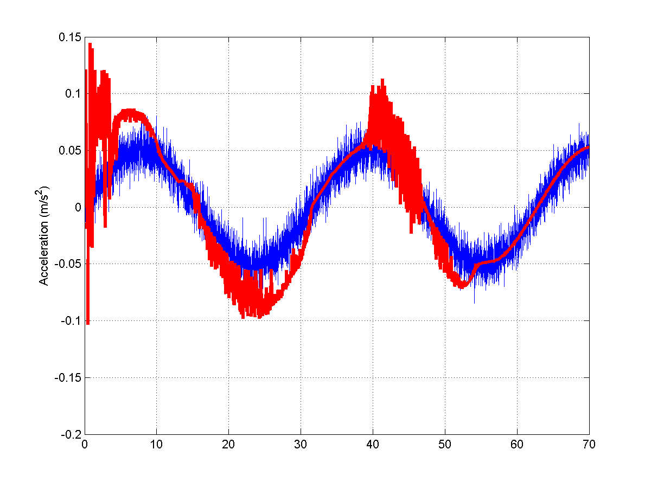
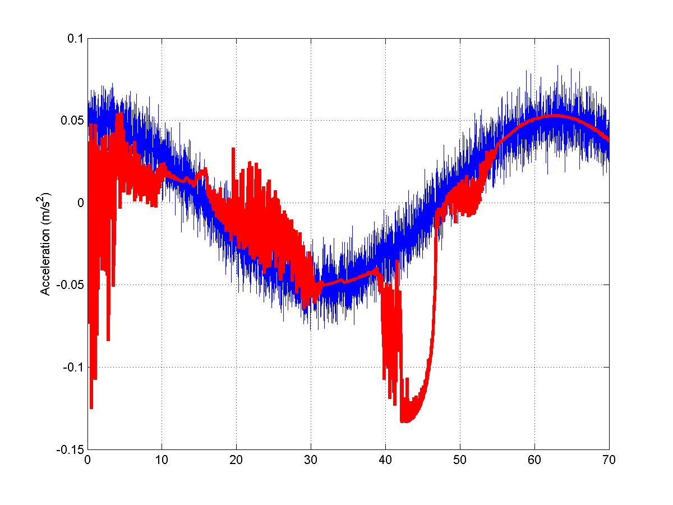
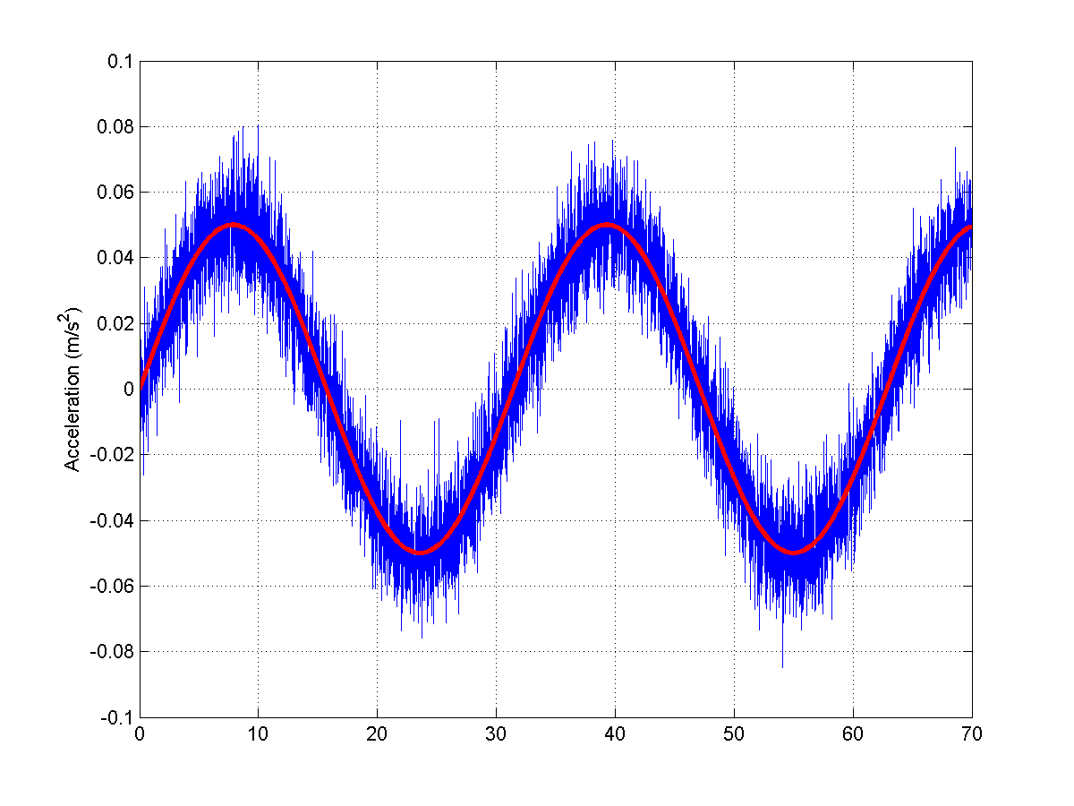
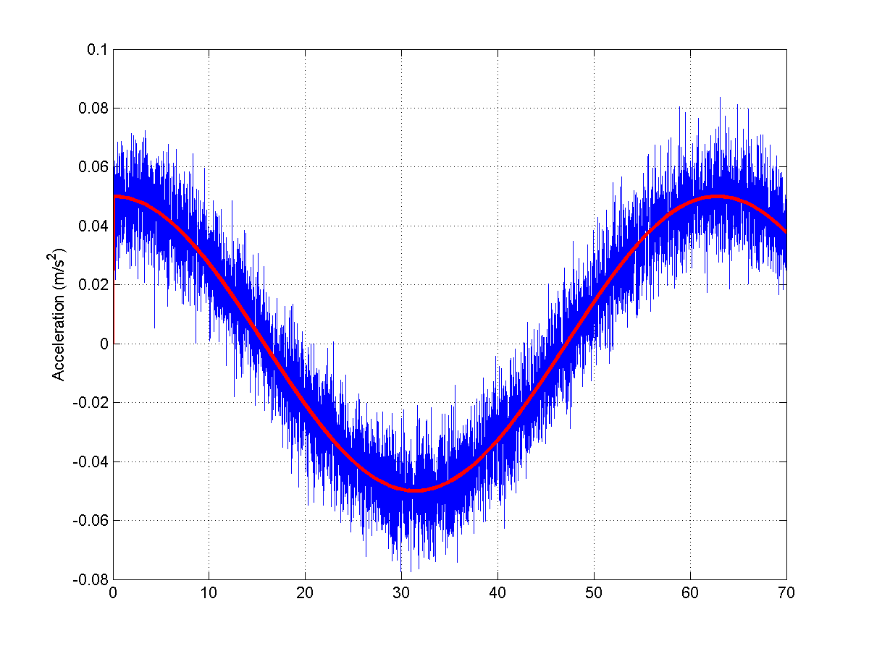
Assistive Spacecraft: No object in grasp
Model 2
Model 1 (true)
X Acceleration
Y Acceleration

Slide 13
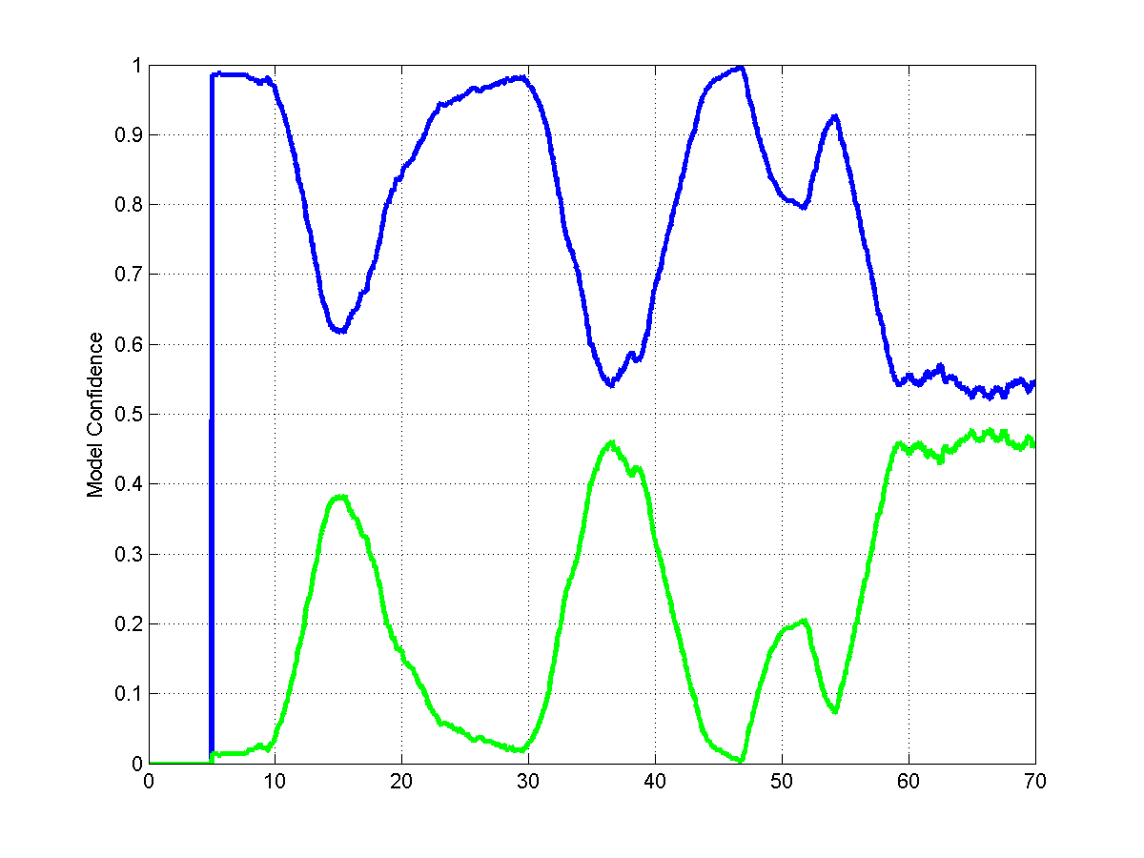
Assistive Spacecraft: No object in grasp
Model 1 (true)
Model 2
Model Confidence

Slide 14
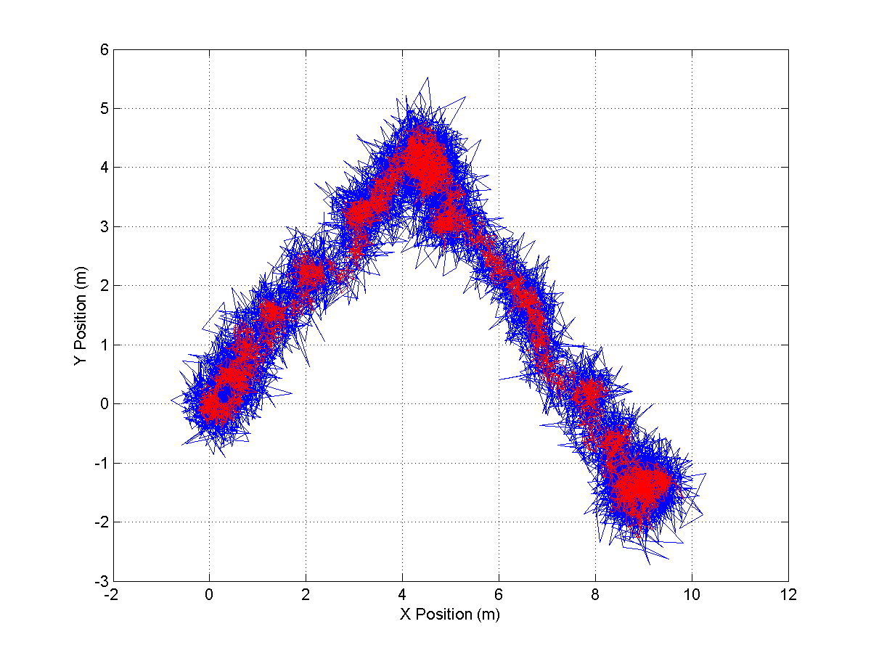
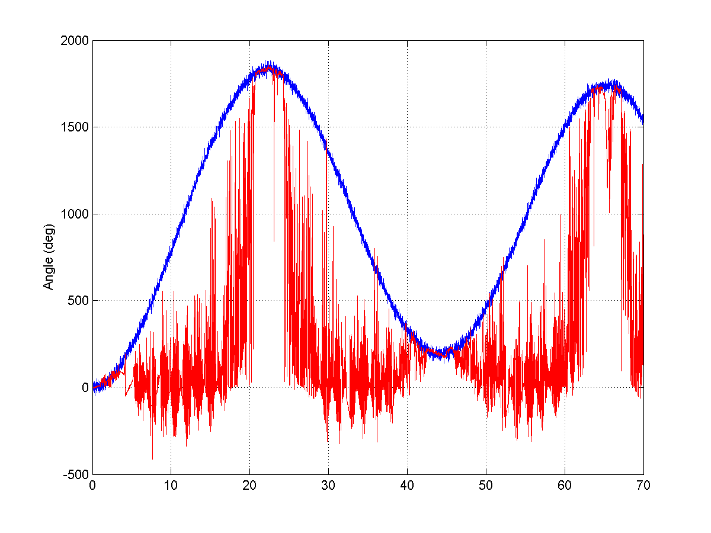

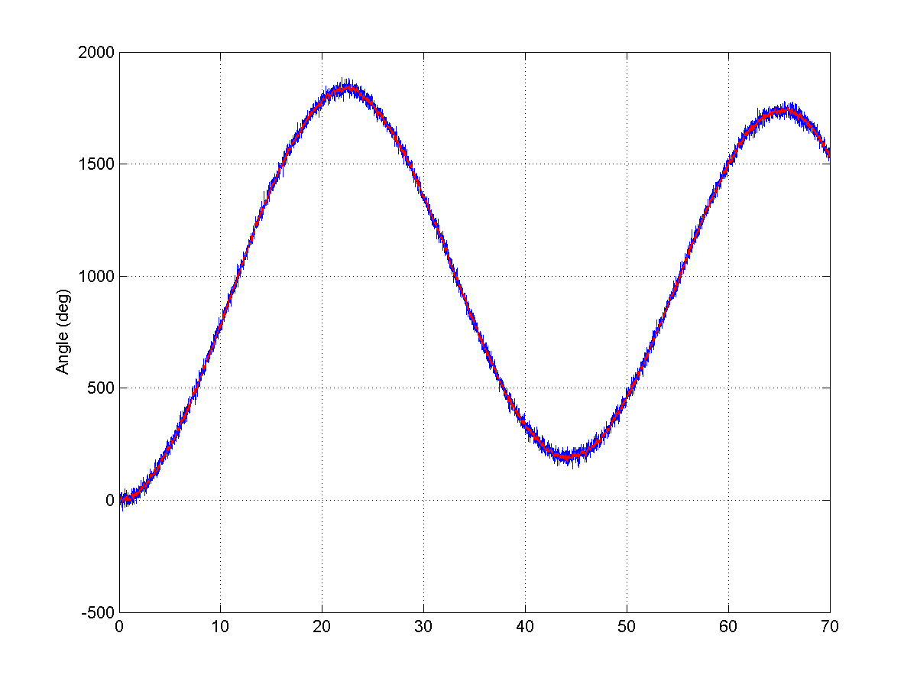
Assistive Spacecraft: With object in grasp
Model 2 (true)
Model 1
Trajectory
Angle

Slide 15
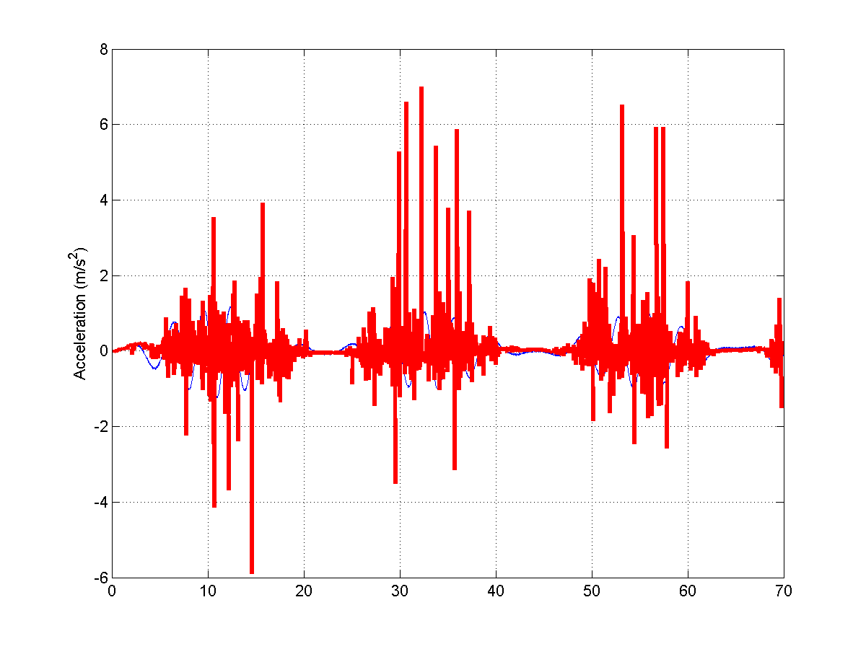
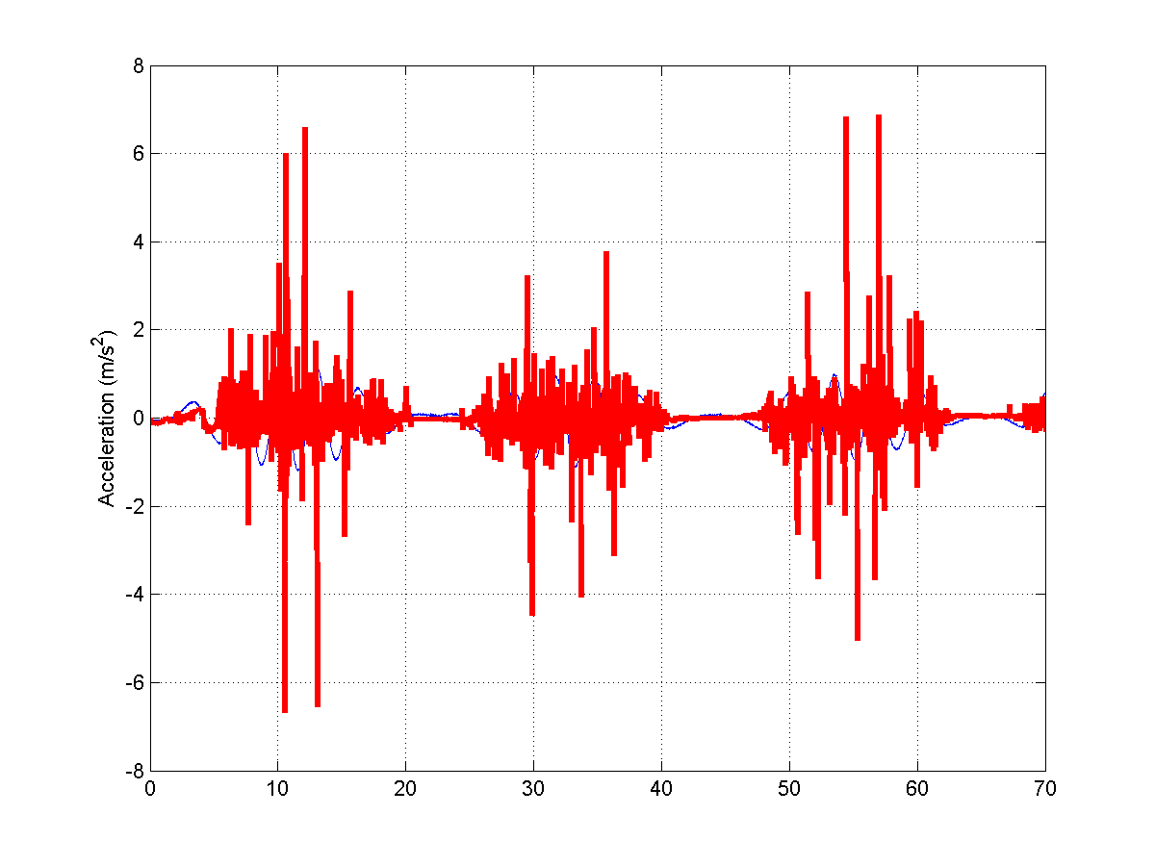
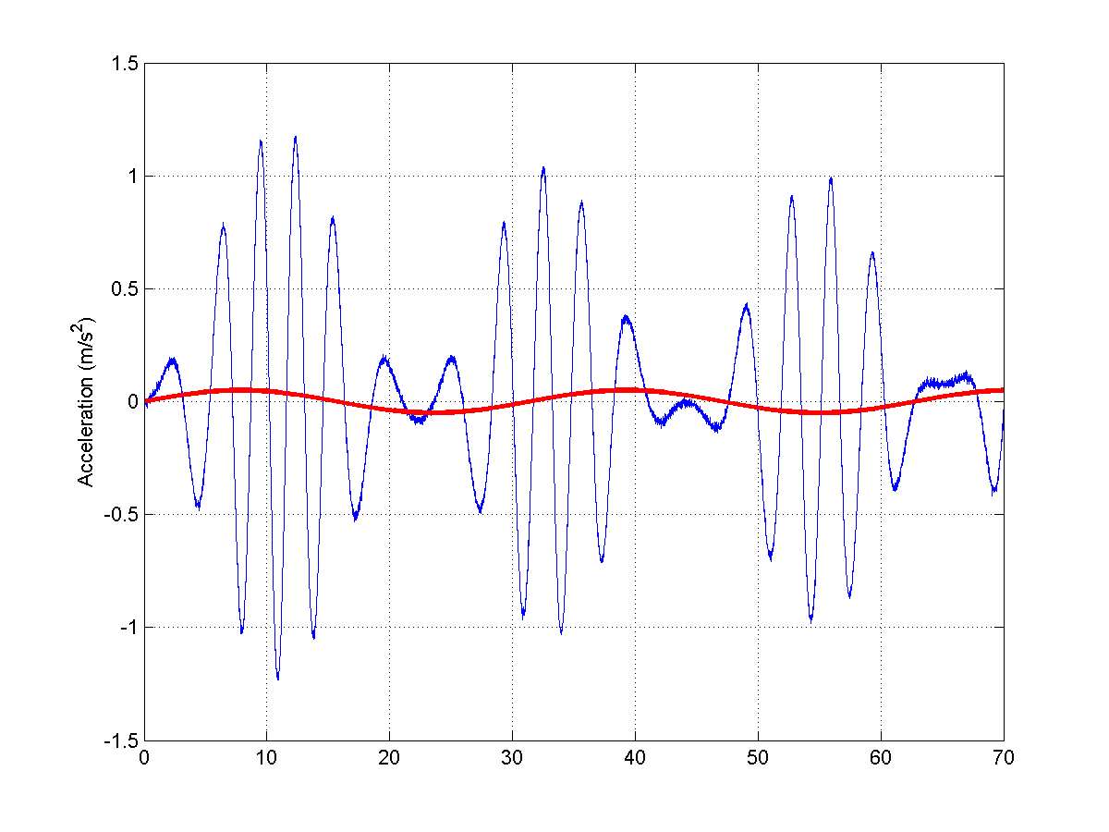
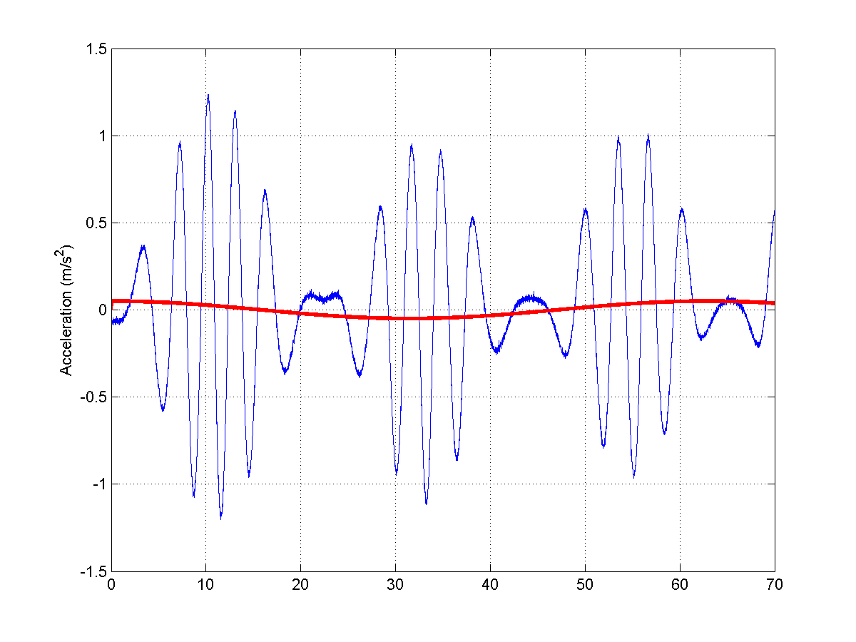
Assistive Spacecraft: With object in grasp
Model 2 (true)
Model 1
X Acceleration
Y Acceleration

Slide 16
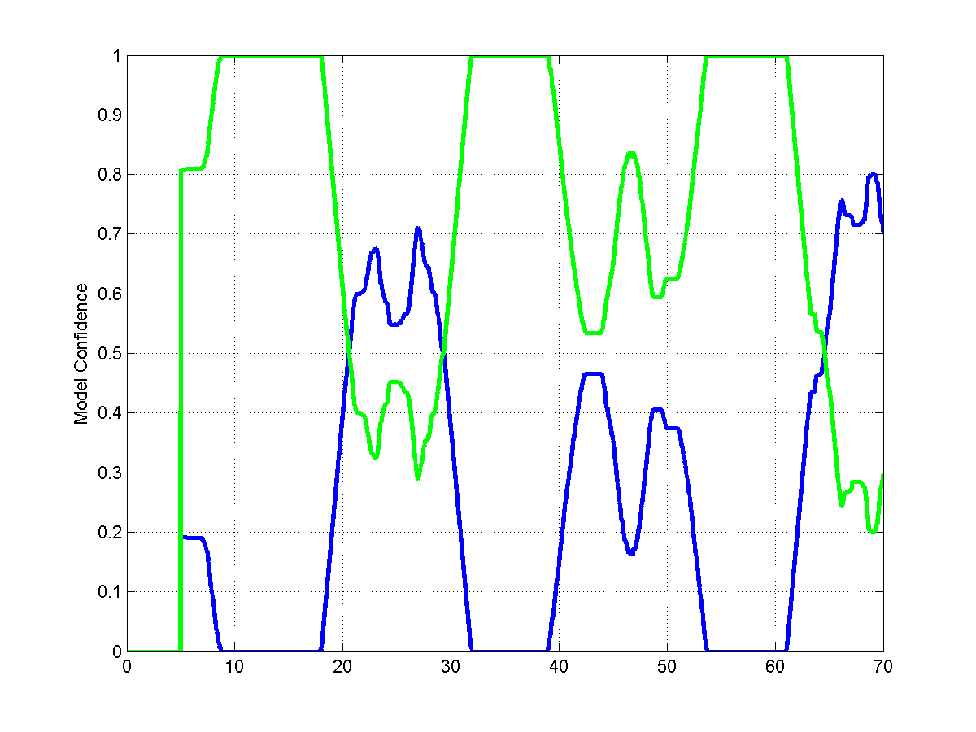
Assistive Spacecraft: With object in grasp
Model 2 (true)
Model 1
Model Confidence

Slide 17
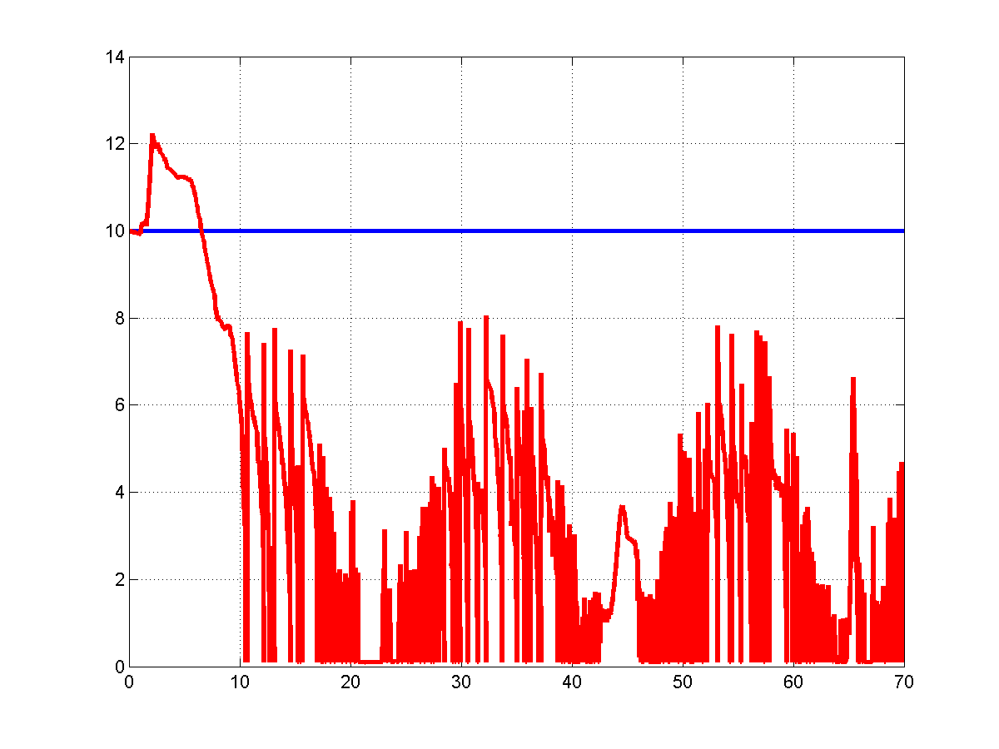
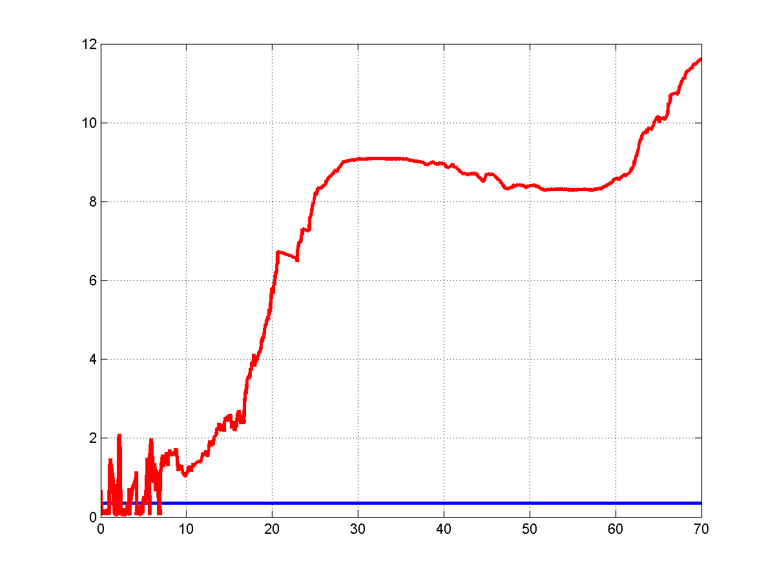
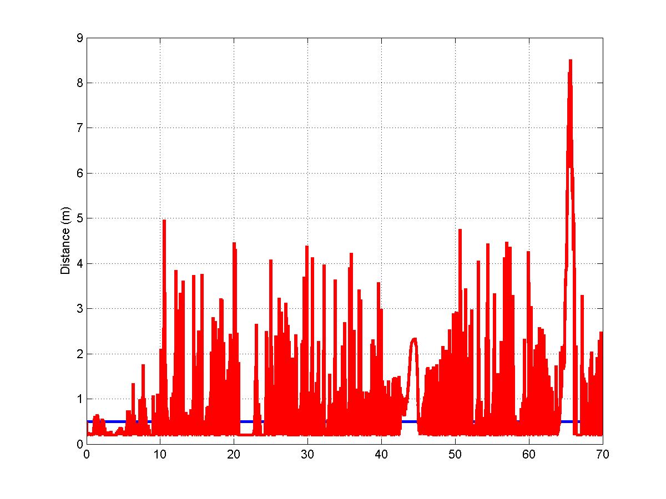
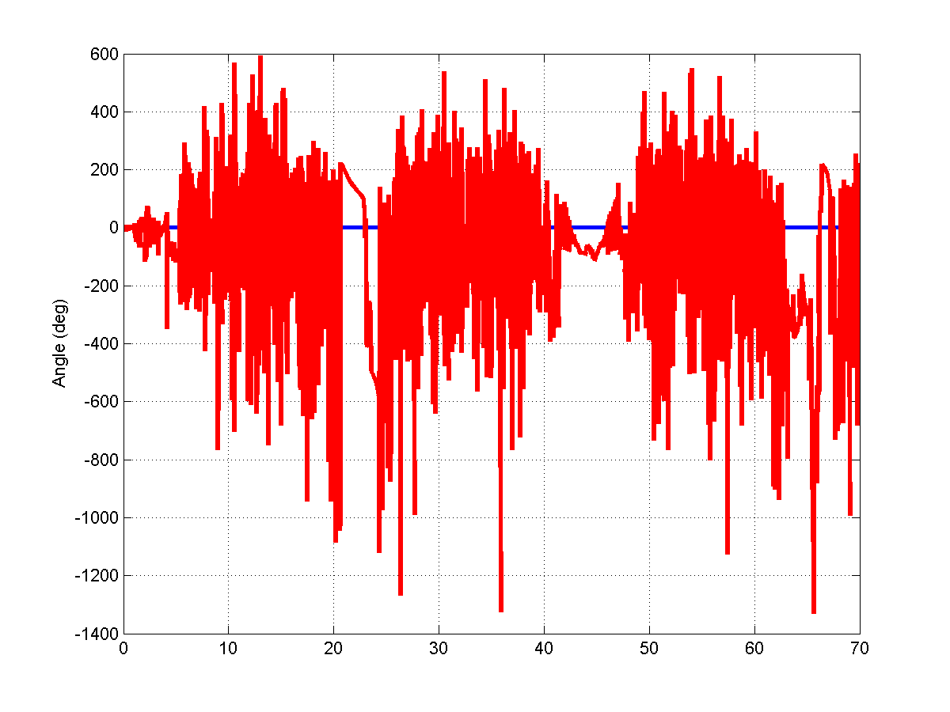
Assistive Spacecraft: With object in grasp
Mass
Moment of Inertia
Distance to Center of Mass
Angle to Center of Mass

